Slide 1
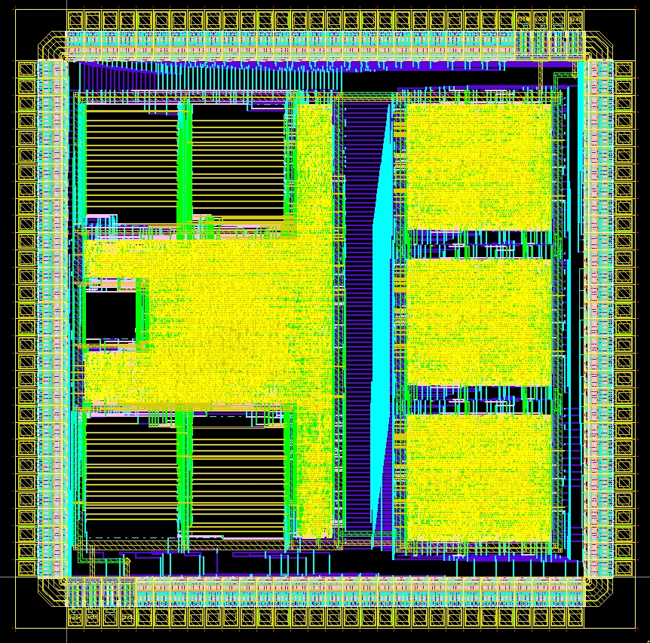
Digital Systems and Microprocessor Design (H7068)
8.1. Intro to UoS educational processor
Daniel Roggen
d.roggen@sussex.ac.uk

Slide 2
UoS Educational Processor
Developed in 2014 for "Digital Systems and Microprocessor Design" at University of Sussex by Daniel Roggen
License: LGPL 2.1
https://github.com/droggen/uos_educational_processor.git
https://opencores.org/project,uos_processor

Slide 3
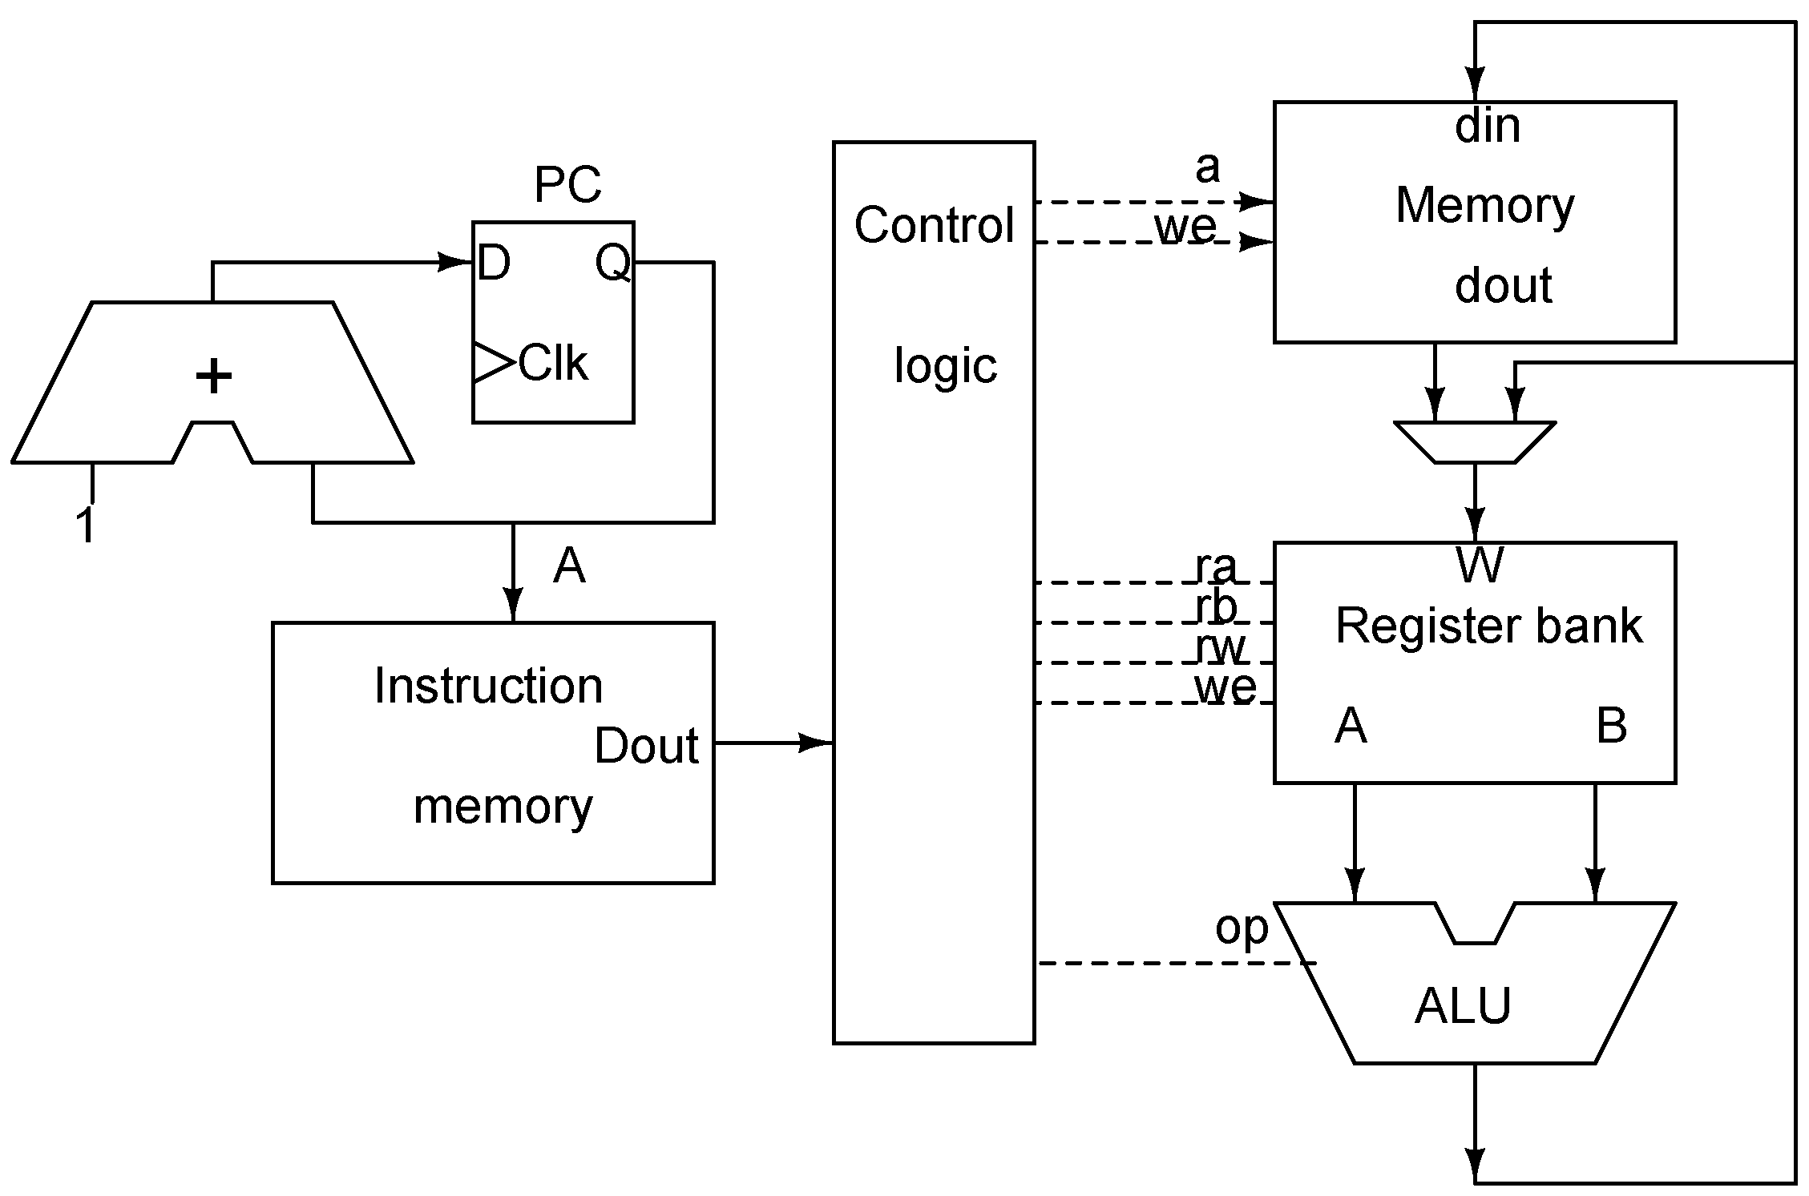
General processor
program counter
Instruction and data memory outside of processor
  One reason: different semiconductor technologies
  Higher densities with dedicated chips

Slide 4
What's next: Educational Processor
8-bit, 4 register processor, Von Neumann architecture
3 clock cycle per instruction
16-bit instruction set (inspired by x86 ISA)
  Direct, indirect, immediate, register addressing
Customizable instructions
External memory bus (for program/data)
I/O interface (as in microcontrollers)
Implemented in VHDL
Synthesizable

Slide 5
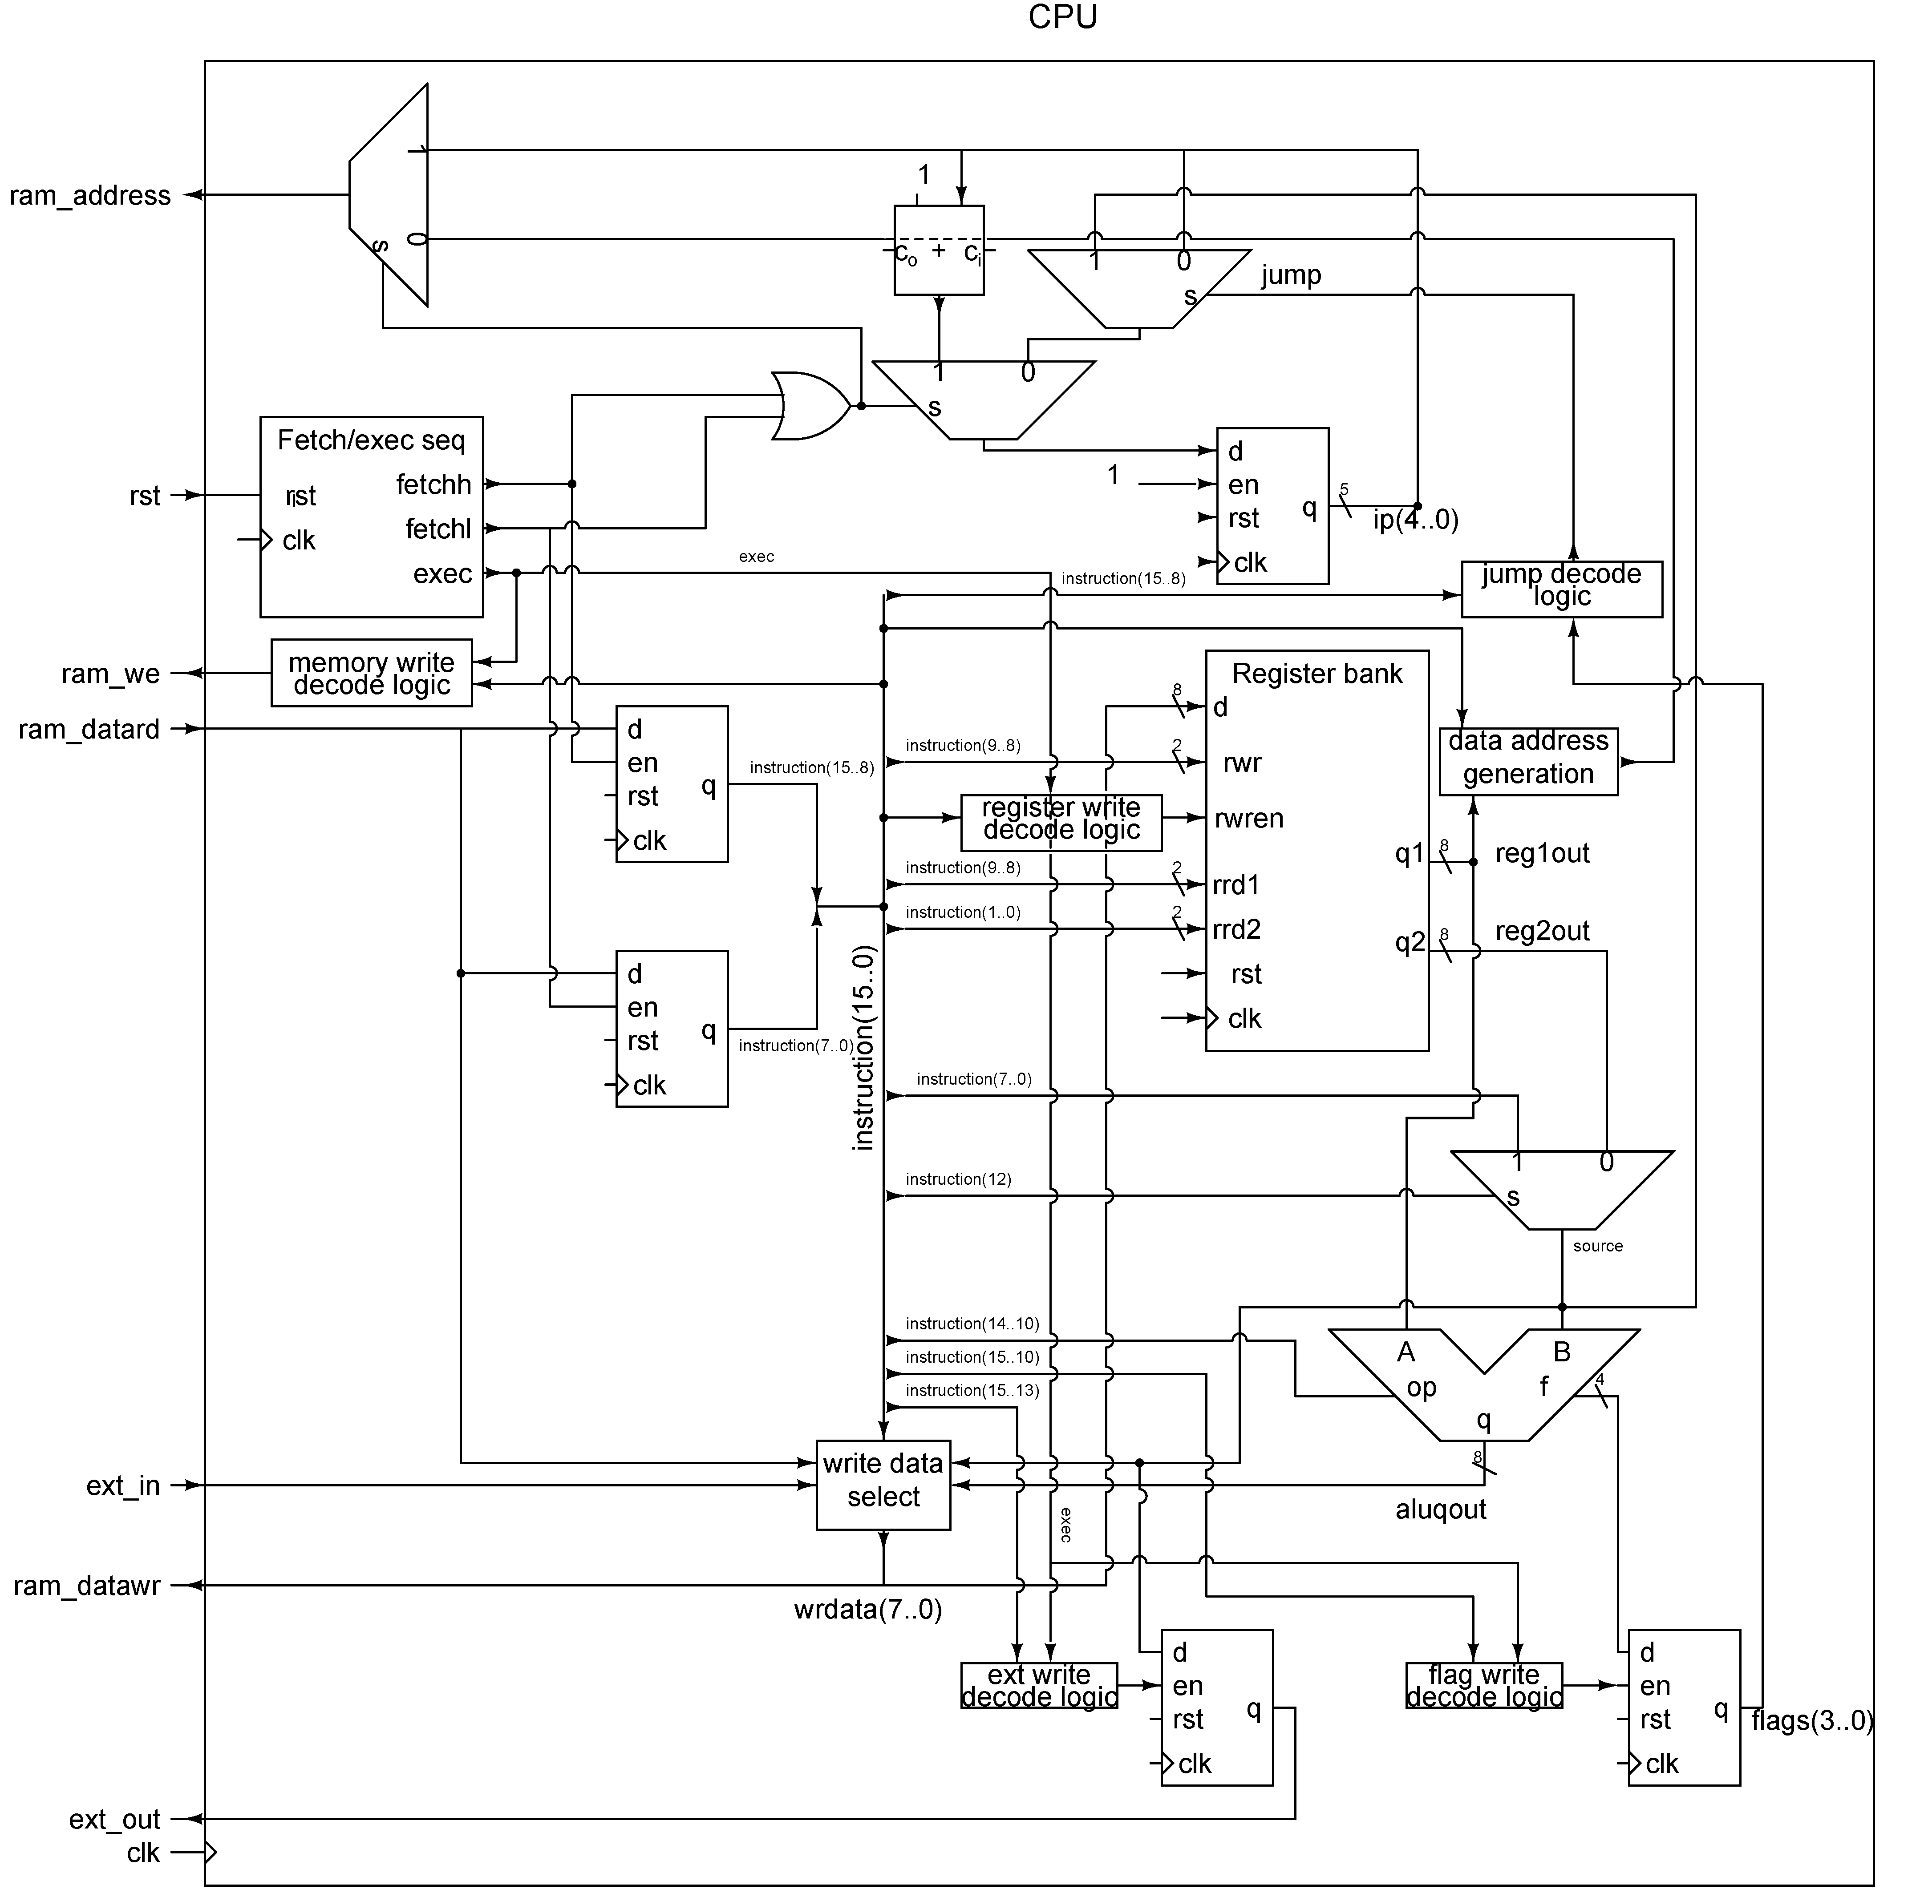

Slide 6
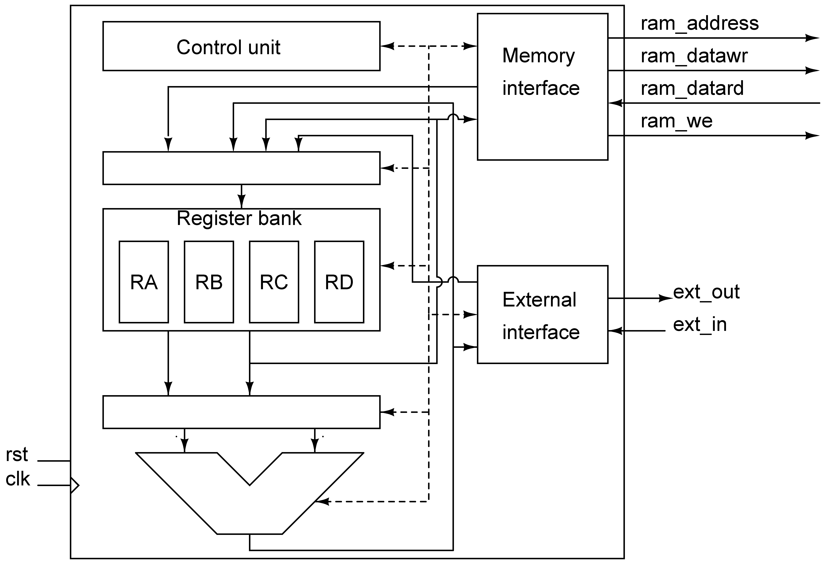
Educational processor overview
Control unit: loads the instruction from memory and controls its execution
  Memory interface: whether to read or write memory (we: write enable), where to read (address), the data to write (datawr) and gets the data from memory with datard
  External interface: whether to write or read
  The ALU operation
  The input to the register bank
  The input to the ALU

Slide 7
Educational processor overview
Register bank: 4 8-bit registers RA,RB,RC,RD
  Provides two outputs from any two registers (asynchronous output). Registers to read from are specified by control lines.
  Allows to synchronously write to one register. Register to write to, and whether to write, is controlled by control lines.
  Registers (to read or write) are identified by a 2-bit code: RA=00, RB=01, RC=10, RD=11

Slide 8
Educational processor overview
Register bank input: select data written to the register bank (if a write occurs in the register bank)
Data to register bank can come from: ALU output, memory interface, external interface, another register, or the instruction

Slide 9
Educational processor overview
ALU input: select data fed to ALU
ALU input data can come from the register bank or from the instruction

Slide 10
Educational processor overview
The ALU takes two inputs and performs a logical or arithmetic operation defined according to the control line

Slide 11
Educational processor overview
The external interface allows to read or write data from a parallel interface on the processor
This is commonly used in microcontrollers to connect peripherals (LEDs, buttons)
During a write the interface stores the value to put on ext_out (D FF).
No special operation during read, however more advanced external interfaces could perform signal conditioning (e.g. debouncing)

Slide 12
Educational processor overview
The memory interface allows to connect to an external memory
In this educational processor the memory interface is transparent (no special function).
More advanced processors may have special interfaces to read from DRAM, SRAM, SD cards, etc.

Slide 13
Educational processor overview
Processor ports: memory interface, exernal interface, clock and reset
Reset is synchronous! (occurs on the rising edge of clock)
More advanced processors may have several memory and external interfaces, additional pins to generate "interrupts" (branch of the execution flow when a pin is toggled), etc.

Slide 14
Educational processor on FPGA
Memory
Push button
To LEDs
From switches
The processor is synthesized on the FPGA as any other component with the entity port map syntax.
A 32 bytes memory is synthesized alongsize the processor for program and data. It has 32 entries (5 bit address) of 8 bits
Push buttons allow to generate single clocks to test the processor
LED and switches connected to external interface

Slide 15
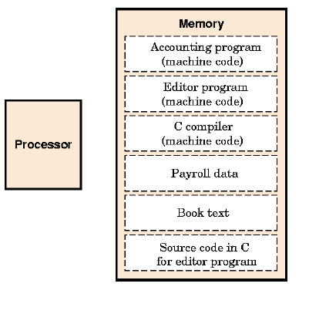
Stored program (von Neumann)
Instructions represented as number in memory
Programs are just like data
However:
  Program goes to the control unit
  Data goes to the data path

Slide 16
Instruction
An instruction defines the operation of the processor when it is executed
An instruction is defined by it's bit-width and whether it is fixed-length or variable length
  Fixed length lead to easier implementation but use more memory
  Variable length can optimize the size for frequent instruction
It comprises multiple fields: opcode (operation code), source, destination, etc.
Different processor architectures have different instruction sets with their own encoding

Slide 17
Instructions in the educational CPU
All instructions are 16-bit wide (fixed size)
3-bit opcode (operation code): indicates the type of operation
The meaning of the remaining bits depends on the opcode!
instr(15..13) | instruction(12..8) | instruction(7..0)
Opcode | depends on the instruction | src

Slide 18
Program counter / Instruction pointer
PC or IP: register in the processor control unit that indicates the memory location where the instruction is fetched
PC starts at zero on reset
As instructions are 16 bits, the first instruction is at memory location 00 and 01; the second instruction at memory location 02 and 03;...
PC incremented continuously for usual instructions
Except with "jump" instructions: the PC changed to fetch instruction from another location

Slide 19
Encoding v.s. "assembler" instruction
All instructions are 16-bit data stored in memory
The instructions can be specified by their binary code:
  1000001010101
Or to simplify reading by their hex code:
  1055h
To further simplify reading we use a human readable format:
  mov ra,55h
We refer to this format as an "assembler" instruction because a software (or human) would read the text "mov ra,55h" and "assemble" the various parts of the encoding to obtain 1055h

Slide 20
Opcodes
Defines the "category" of the instruction
3-bit opcode: total of 8 "categories" of instructions
Defined in order to help the decoding of the instruction.
All instructions of the same opcode share the same encoding
Opcode 000: move instructions
Opcode 001: ALU instructions
Opcode 010: ALU instructions
Opcode 011: ALU instructions
Opcode 100: unused
Opcode 100: ALU instructions
Opcode 101: jump instructions
Opcode 110: external interface instructions
Opcode 111: unused

Slide 21

Move instructions (opcode 000)
Moves data between registers, immediate and memory
mov dst,src
  moves the data specified by source into destination
Instructions | instruction(15..8) |  |  |  |  |  |  |  | Instruction(7..0)
Move | Opcode |  |  |  | dd#m | sd#m | dreg |  | src
mov r, r | 0 | 0 | 0 | 0 | 0 | 0 | r | r | - | - | - | - | - | - | r | r
mov r, i | 0 | 0 | 0 | 1 | 0 | 0 | r | r | i | i | i | i | i | i | i | i
mov r, [r] | 0 | 0 | 0 | 0 | 0 | 1 | r | r | - | - | - | - | - | - | r | r
mov r, [i] | 0 | 0 | 0 | 1 | 0 | 1 | r | r | i | i | i | i | i | i | i | i
mov [r], r | 0 | 0 | 0 | 0 | 1 | 0 | r | r | - | - | - | - | - | - | r | r
mov [r], i | 0 | 0 | 0 | 1 | 1 | 0 | r | r | i | i | i | i | i | i | i | i

Slide 22
immediate/register
the src field contains the "source" data for the instruction (sometimes unused)
Source can be immediate or register depending on R'/I
R’/I=1: src is an immediate: the 8 LSBs in the instruction are used as the data
R’/I=0: src is a register: the data comes from a register. The register is specified by the 2 least significant bits in src
  RA: 00
  RB: 01
  RC: 10
  RD: 11
Instructions | instruction(15..8) |  |  |  |  | Instruction(7..0)
Move | Opcode |  | dd#m | sd#m | dreg | src

Slide 23
direct/indirect
Source: direct or memory mode specified by sd#m
Direct mode: the value of a register or immediate is moved to dst
Memory mode: the instruction fetch the data from the memory location specified by src (which can be immediate or register)
Syntax: use brackets around src to indicate memory mode
  mov ra,[55h]
Instructions | instruction(15..8) |  |  |  |  | Instruction(7..0)
Move | Opcode |  | dd#m | sd#m | dreg | src

Slide 24
destination
Destination is always a register (direct) or a memory location (memory mode) specified by a register, depending on dd#m
Direct mode: the value of source is moved to a register
Memory mode: the instruction will fetch the data from a memory location.
Syntax: use brackets around dst to indicate memory mode
  mov [ra],55h
Instructions | instruction(15..8) |  |  |  |  | Instruction(7..0)
Move | Opcode |  | dd#m | sd#m | dreg | src

Slide 25
Move examples
mov ra,rb:
  src is direct, register: moves the content of reg b into reg a
  dst is direct register
mov ra,13h:
  src is direct, immediate: moves 13h into reg a
  dst is direct register
mov ra,[rb]
  src is memory, register: moves the data at the memory location b into a
  dst is direct register
mov ra,[13h]:
  src is memory, immediate: moves the data at the memory location 13h into a
  dst is direct register
mov [ra],rb:
  src is register:
  dst is memory: moves the content of reg b into reg a

Slide 26
ALU (opcodes 001,010,011)
Performs an arithmetic/logic operation on one or two operands
instr dst, src
  Performs a two operand operation on dst and src and puts the result in dst
instr dst
  Performs a single operand operation on dst and puts the result in dst
dst is always a register
src is a register or an immediate

Slide 27

ALU: two operands
ALU op indicates which ALU operation
src: source (immediate/register according to R'/I)
dst: destination
Instructions | instruction(15..8) |  |  |  |  |  |  |  | Instruction(7..0)
ALU 2 op | opcode |  |  |  | ALU op |  | dreg |  | src
add r, r | 0 | 0 | 1 | 0 | 0 | 0 | r | r | - | - | - | - | - | - | r | r
add r, i | 0 | 0 | 1 | 1 | 0 | 0 | r | r | i | i | i | i | i | i | i | i
sub r, r | 0 | 0 | 1 | 0 | 0 | 1 | r | r | - | - | - | - | - | - | r | r
sub r, i | 0 | 0 | 1 | 1 | 0 | 1 | r | r | i | i | i | i | i | i | i | i
and r, r | 0 | 0 | 1 | 0 | 1 | 0 | r | r | - | - | - | - | - | - | r | r
and r, i | 0 | 0 | 1 | 1 | 1 | 0 | r | r | i | i | i | i | i | i | i | i
or r, r | 0 | 0 | 1 | 0 | 1 | 1 | r | r | - | - | - | - | - | - | r | r
or r, i | 0 | 0 | 1 | 1 | 1 | 1 | r | r | i | i | i | i | i | i | i | i
xor r, r | 0 | 1 | 0 | 0 | 0 | 0 | r | r | - | - | - | - | - | - | r | r
xor r, i | 0 | 1 | 0 | 1 | 0 | 0 | r | r | i | i | i | i | i | i | i | i

Slide 28
Examples
add RA,RB
  Stores RA+RB in RA
sub RA,03h
  stores RA-3 in RA.
and RD,55h
  stores the logical AND of RD and 55h in RD
Always indicate numbers by a 2 digit with an h at the end for hex!
Avoids confusion between register RA and value Ah

Slide 29
ALU: comparison
Comparison: cmp dst,src
src: source (immediate/register according to R'/I)
dst: destination
Comparison is performed by subtracting src from dst!
Result of the comparison is stored in flags: carry and zero
  Zero=1 Carry=0: dst=src
  Zero=0 Carry=0: dst>src
  Zero=0 Carry=1: dst<src
Result of comparison used by conditional jump
Test | opcode |  |  |  | ALU op |  | dreg |  | immedite / reg
cmp r, r | 0 | 1 | 0 | 0 | 0 | 1 | r | r | - | - | - | - | - | - | r | r
cmp r, i | 0 | 1 | 0 | 1 | 0 | 1 | r | r | i | i | i | i | i | i | i | i

Slide 30
ALU: one operand
Format: instr dst
The operation is applied on dst and the result is in dst
Example:
  not ra
  asr rb
Instructions | instruction(15..8) |  |  |  |  |  |  |  | Instruction(7..0)
ALU 1 op | opcode |  |  | ALU op |  |  | dreg
not r | 0 | 1 | 1 | 0 | 0 | 0 | r | r | - | - | - | - | - | - | - | -
shr r | 0 | 1 | 1 | 0 | 0 | 1 | r | r | - | - | - | - | - | - | - | -
ror r | 0 | 1 | 1 | 0 | 1 | 0 | r | r | - | - | - | - | - | - | - | -
asr r | 0 | 1 | 1 | 0 | 1 | 1 | r | r | - | - | - | - | - | - | - | -
rol r | 0 | 1 | 1 | 1 | 0 | 0 | r | r | - | - | - | - | - | - | - | -

Slide 31
Jumps (opcode 101)
Unconditional jumps: changes the value of PC to destination
  jmp dst
Conditional jumps: changes the value of PC if a condition is met. Condition is tested by checking the flags (carry, zero). Flags are set by a prior comparison
JA: jump if above
  Jumps if Zero=0 and Carry=0
JB: jump if below
  Jumps if Zero=0 and Carry=1
JE: jump if equal
  Jumps if Zero=1

Slide 32
Compare / jump examples
Carry Zero
mov ra,0Ah 0 0
cmp ra,09h 0 0
cmp ra,0Ah 0 1
cmp ra,0Bh 1 0

Slide 33
Compare / jump examples
Carry Zero
mov ra,0Ah 0 0
cmp ra,09h 0 0
jb dst1 -- not taken: RA not below 9h
je dst2 -- not taken: RA not equal 9h
ja dst3 -- taken: RA above 9h

Slide 34
Compare / jump examples
Carry Zero
mov ra,0Ah 0 0
cmp ra,0Ah 0 1
jb dst1 -- not taken: RA not below Ah
je dst2 -- taken: RA not equal Ah
ja dst3 -- not taken: RA not above Ah

Slide 35
Compare / jump examples
Carry Zero
mov ra,0Ah 0 0
cmp ra,0Bh 1 0
jb dst1 -- taken: RA below Bh
je dst2 -- not taken: RA not equal Bh
ja dst3 -- not taken: RA above Bh

Slide 36
External interface (opcode 110)
Instructions | instruction(15..8) |  |  |  |  |  |  |  | Instruction(7..0)
IO | opcode |  |  |  | IO type |  | dreg |  | src
out r | 1 | 1 | 0 | 0 | 0 | 0 | - | - | - | - | - | - | - | - | r | r
out i | 1 | 1 | 0 | 1 | 0 | 0 | - | - | i | i | i | i | i | i | i | i
in r | 1 | 1 | 0 | - | 0 | 1 | r | r | - | - | - | - | - | - | - | -
Out: write register or immediate to the external interface
In: read data from the external interface into a register

Slide 37
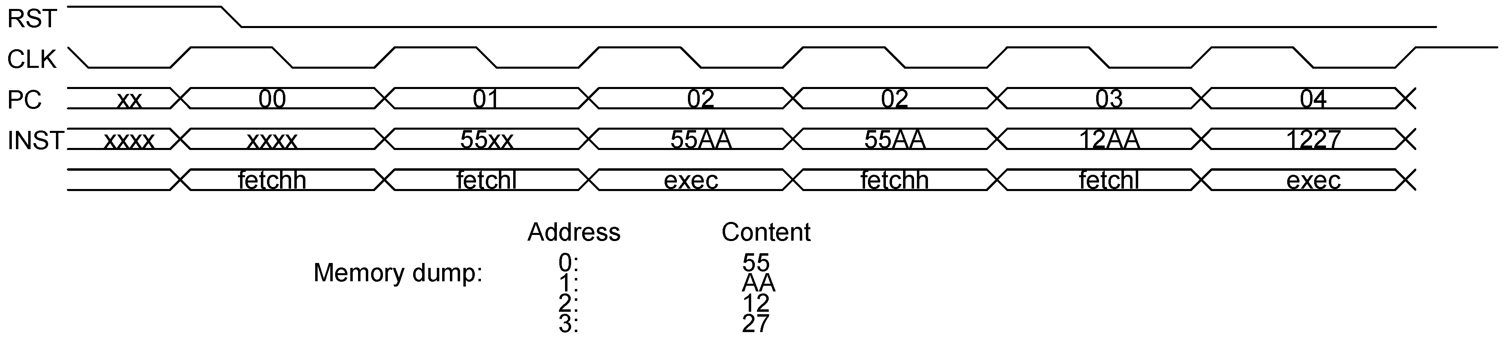
Instruction fetch and execution
Instructions are 16 bit but memory is 8 bit!
Two cycles needed to fetch the instruction
One cycle for execution
Consequence: 3 clock cycles per instruction

Slide 38
Summary
The architecture and features of the processor are clear at a high level
The characteristics of the instruction set are understood:
  Instruction execution time
  Instruction encoding
  Instruction set (move, alu, jump, external) and its characteristics (register/immediate, direct/memory)

